Slide 1


Bank of Baroda Hackathon - 2022
Technology Partner
Your Team Name : CODEXX
Your team bio : We are a team of passionate engineers, who loves to solve real world problems.
Date : 20.09.2022

Slide 2
Problem Statement?
Bank handles large volumes of cheques in the clearing process. The process involves many technical verifications including signature verification. Some of these steps are manual and require human intervention to complete the process. The current process requires a high human capital deployment and longer processing time.
Therefore, to give accurate verification with minimal amount of time and also to reduce the human involvement in clearing process.
We are trying to create an automated cheque processing system.

Slide 3
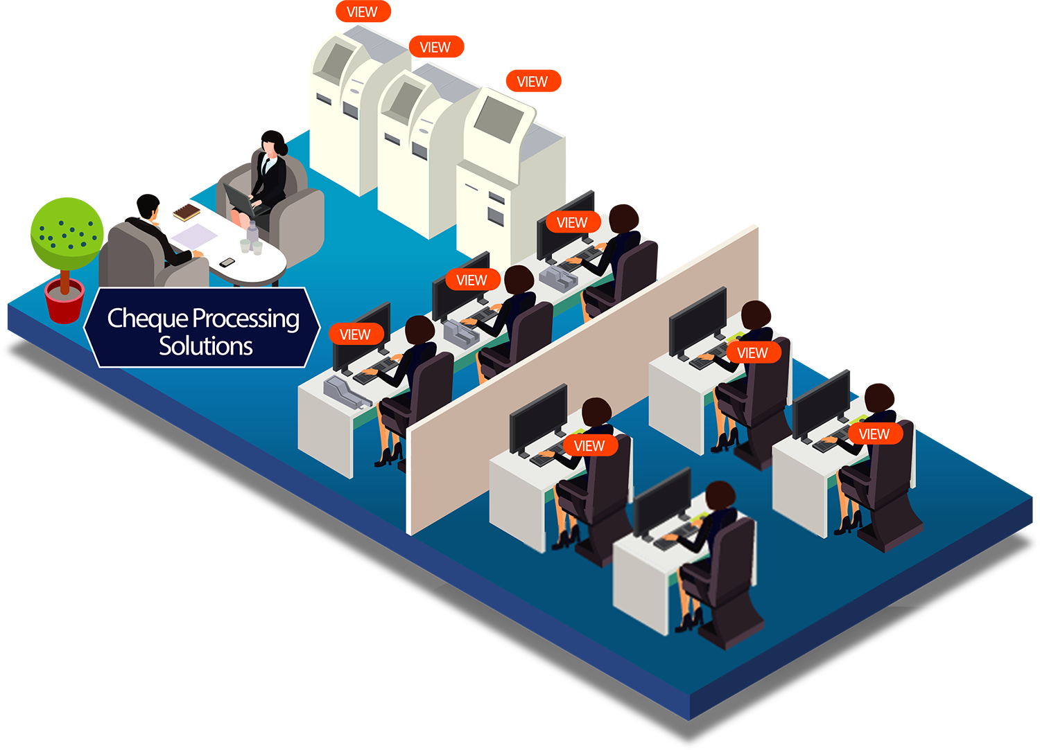
User Segment & Pain Points
To prevent the payment of a cheque to a wrongful holder.
To assure safe payment of money to the genuine receiver of the proceeds of the cheque.
To assure safety in circulation of cheques.
To reduce the processing time and processing cost.
To help cheque truncation.

Slide 4
Pre-Requisite
Tech Stack to be used:
Python
Flask
Open CV
Magnetic character recognition
Transfer and Federated learning methodologies
Convolution Neural Networks
What are the alternatives/competitive products for the problem you are solving?
The procedure for clearing cheques is currently being developed.
Many of the key competitors continued to work on their product. Accuracy is the key factor that counts.
A densely layered network that comprehends the intricacy of the data can produce the greatest metrics.
Alternatives to our concept are now in the development stage rather than on the market.

Slide 5
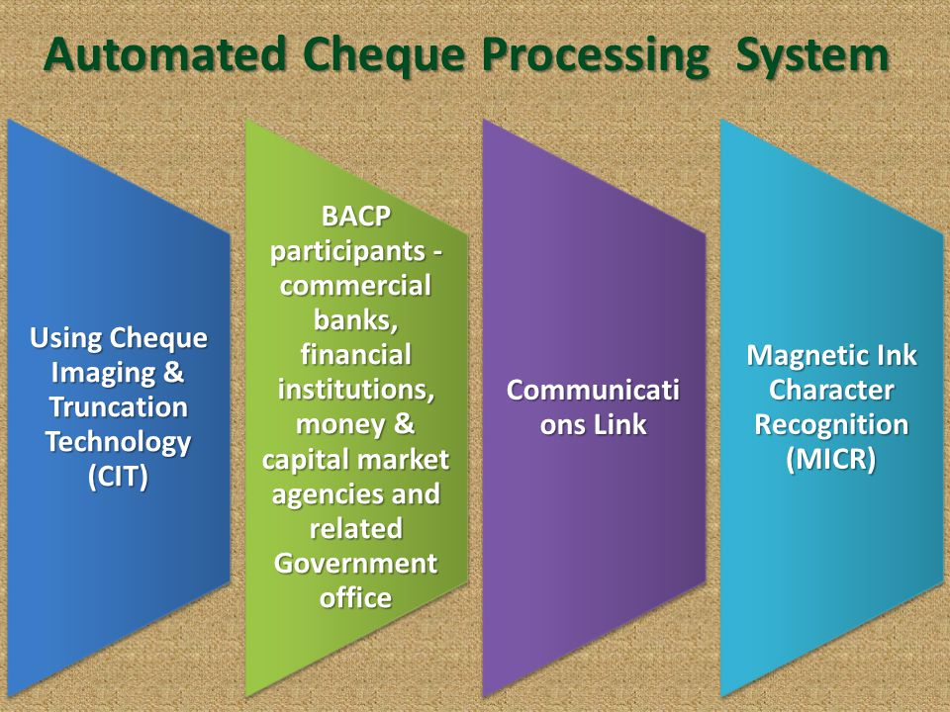
Azure tools or resources
Azure is useful for scaling the Machine learning models that we used to deploy in clouds. As the cheque clearing process is tedious, it involves a lot of computation power. With the help of Azure ML designer the computation needs can be automated and done in a easier manner. Azure helps us to deploy the pipeline for the whole project management. It also helps us to integrate our pipelines with other cloud services, Where we can embed our services with leading tech stack.

Slide 6
Any Supporting Functional Documents
Our model enables for speedier check clearing by Automated Cheque Processing (ACP). Paper cheques were once physically processed, which may take up to seven days to clear. These algorithms are intended to pre-process a scanned image of a cheque, find and extract various pieces of data from it, and generate recognition results for these items utilizing models established for each function.

Slide 7
Key Differentiators & Adoption Plan
Instead of submitting a real cheque for clearing, the presenting bank uses appropriate technology and software to take a picture of the paper cheque.
The picture will then pass through numerous clearing stages before the transaction is finalized using the image data.
We are employing a hybrid model comprised of many algorithms.
This model assists in processing the check in an efficient and timely manner.
This AI-based technique provides high processing accuracy.

Slide 8
GitHub Repository Link & supporting diagrams, screenshots, if any
It can really impact the banking sector by drastically improving the speed of cheque verification.
Banks can truly improve their efficiency and customer satisfaction by implement this method.
Hence soon, after its implementation it will replace the normal stagnant time-consuming cheque verification process.
GITHUB LINK : https://github.com/Codexx-05/Automated-Cheque-Processing

Slide 9
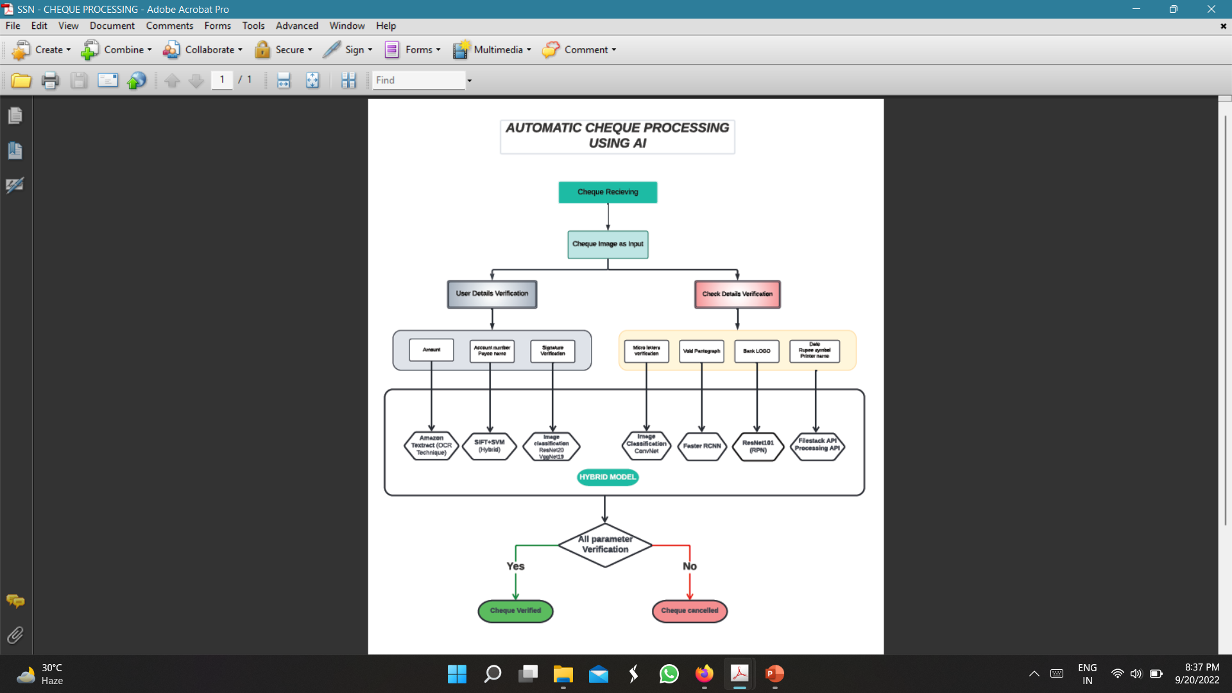
Ideation diagram:

Slide 10
Thank You
Team member names:
Kishore Akash YS – Knowledge Institute of Technology
Mythili K – Knowledge Institute of Technology
Karthikeyan R – Knowledge Institute of Technology
Sharan MV – Knowledge Institute of Technology

